Slide 1


Overview of Integrated Algorithm and Event Library

Slide 2







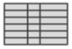


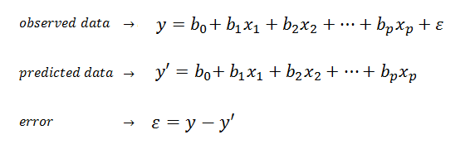
Integrated Algorithm captures impact from multiple factors to enable accurate sales attribution
Automatic feature selection
Business Intuition check
Data treatment & variable transformation
Business sense
Outlier treatment
Feature selection algorithm for scalability and accuracy
Apply business intuitions on model equations
Raw data
Variables
Analytical dataset
Initial prediction & coefficients
Data Quality Check
Final
predictions & coefficients
Transformation
Missing data treatment
IA: Stepwise bidirectional regression
Drug IA: Ridge regression
Key coefficients magnitude & directionality should pass business intuition test
Final models & prediction levels
Model equations
Efficiency & scalability of feature selection
Individual models Level: Account - Product | ~170 Accounts 5 Sales channels ~220 Products
National models Level: Product | ~220 Products 6 categories
~35,000 (~80% of total) account/product combinations are modeled
Error is under 25% for key account /products
Error is under 30% for 75% of models
IA Model Coefficients are refreshed quarterly

Slide 3






Data treatment and variable transformation help to effectively capture the contribution of each factor
Price Elasticity
Value of the Week
Prices are splined into promotional and non promotional price based on a discount higher than 10% on Everyday Value (EDV)
Seasonality and temperature variations by region
Performance of product sales during the holiday period (including the pre & post holiday weeks)
Execution
Product Portfolio
Impact of in-store product execution, based on
# Cases on display
% stores in which product was on display
Execution level threshold based on national execution standards
Cannibalization due to the price variations of competitor products, intra products and price in cross-retail stores
Feature
Pantry Loading
Impact of
% stores in which a product is on an advertisement
Position of advertisement (front/middle/back of a pamphlet)
Loss in volume in subsequent weeks, due to customers stockpiling products in deep discount weeks.
Deep discount: discount higher than 25% of EDV
EDV (Everyday Value) is calculated as the 95th percentile price at an Account/Product/Year level.
It is an estimate of Perception price that a customer would expect for a product from any retailer.
* Positive lift
* Negative lift

Slide 4
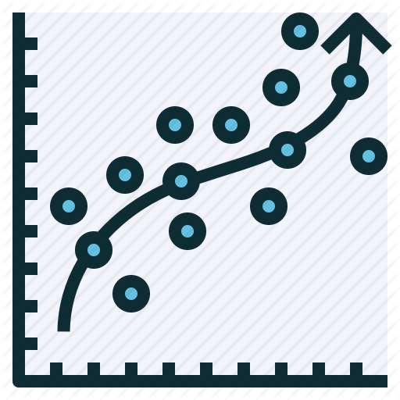

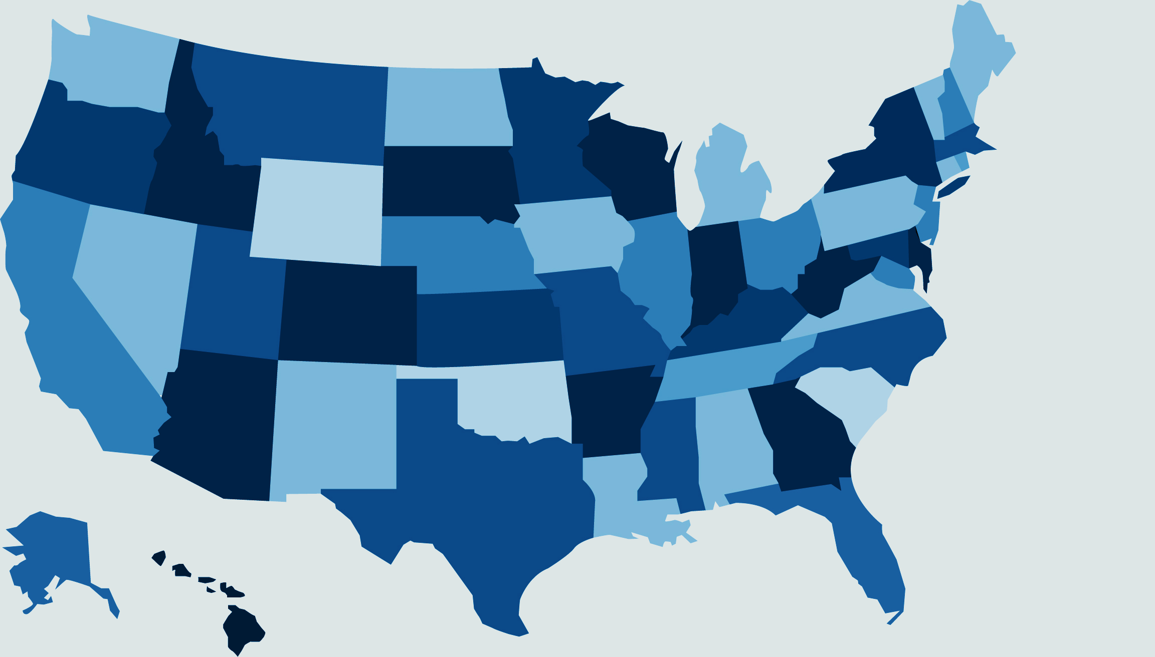
Automatic feature selection using stepwise regression is the core engine of Integrated Algorithm
Stepwise bidirectional linear regression model considers a variable for addition to or subtraction from the set of explanatory variables based on the adjusted R-square value and the p-value.
Automatic feature selection enables us to build 35,000+ models in less than 30 minutes
Models are built at two levels
New modeling technique for Drug channel
Individual Model
Built at account-product level
Coefficients used in calculating baseline & predicted volume
Contribution of 7 variable buckets calculated using this model
National Model
Built at a product level for considering all accounts
Temperature & holiday coefficients obtained from this model National models are run separately for drug and value channels
Ridge regression
Instead of the removing the variables, the model penalizes for larger coefficient magnitude
Updated variables to capture channel specific attributes
- Considered new holiday variables
- Incorporated dynamic comp-intra mapping
- Included Cross retail - Intra portfolio
- Introduced simple and complex feature types
Accuracy: 80% account-product combinations have MAPE less than 30%

Slide 5



Business Intuition Check is applied to make final attribution more consumable
Parallelization of 35,000+ model build sometimes lead to counter-intuitive betas because of incorrect/missing data
To make the final output more consumable, we apply business sense to cap the direction and magnitude of the coefficients obtained from the models
This allows the teams to obtain consumable attribution of sales volume
Coefficients of about 15% models undergo a standardization of magnitude and directionality

Slide 6










The Event Library serves as the single source of truth by integrating multiple sources of information to generate key sales performance metrics
Weekly retail sales data
600+ KPIs
for volume lift, financial ROI and
promotion effectiveness
200+ products
across 7 categories
170+ accounts
across 5 channels
3+ years of promotion data
Retail sales from Kroger and Non-Nielsen retailers
Efficient ETL
Quality control
Features & promotional data
Household counts across customer loyalty segments (CPO)
CAS Financial metrics of bottler revenue from retailers
Event Library is updated every 2 weeks

Slide 7
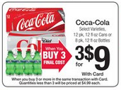

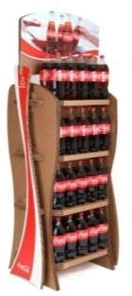
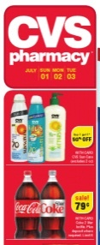


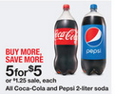

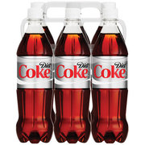
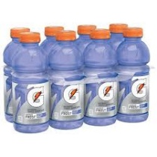




Waterfall charts created using Event Library & Integrated Algorithm help in understanding of factors affecting weekly sales
KPIs from Event Library are combined with model coefficients from the Integrated Algorithm to generate waterfall charts for accurate sales attribution
How do we capture the individual effect of each variable?
The contribution of individual variables in the waterfall is calculated by taking the actual value of that variable and the EDV value of the rest in the model equation
Feature
Intra-portfolio
Execution
Pantry loading
Value of the week (VOW)
Competition
Cross Retail
Price
Other Factors
Basel is the sales volume of a product in an account on a given day without any external factors
How did the retail compare to recent weeks?
Was this a great week or a great promo?
Was display support better or worse than average?
What was the value of featuring the event in an ad feature?
What are the best package combos to drive the highest lift for the portfolio?
Did a recent hot promo impact this week’s results?
How did competitive promos affect our (and retailer) results?
Did competing retailers run strong or weak promos?
Price, Feature and Execution are the primary variables that lift the sales volume
Price variations of competitor products, intra products, product in cross-retail stores and pantry loading are the variables that pull the volume down
Base
Actual

Slide 8


The process of generation & consumption of Waterfall charts is fully streamlined - efficient data and models creation, user friendly visualizations and end-user communication
Visualization
Actions and insights
Results generation
Results
Modeling
Data
Efficient Event Library creation process
360 degree view of a promotion
Multiple quick analysis on ideal size of display, value of execution etc.
Tableau based visualization
Monthly Action Insights session with 200+ retailers to educate them on running successful promotions
Scorecard evaluation to check promotion compliance
Annual Planning Symposium to help retailer plan their promotions based off the imperatives
30K+ models using automatic feature selection
Exhaustive Quality & business intuition checks
Increased Velocity of Delivery with Bi-weekly & Quarterly refreshes | Working in conjunction with multiple stakeholders & across different platforms |
Iterative Engine to incorporate continuous feedback

Slide 9
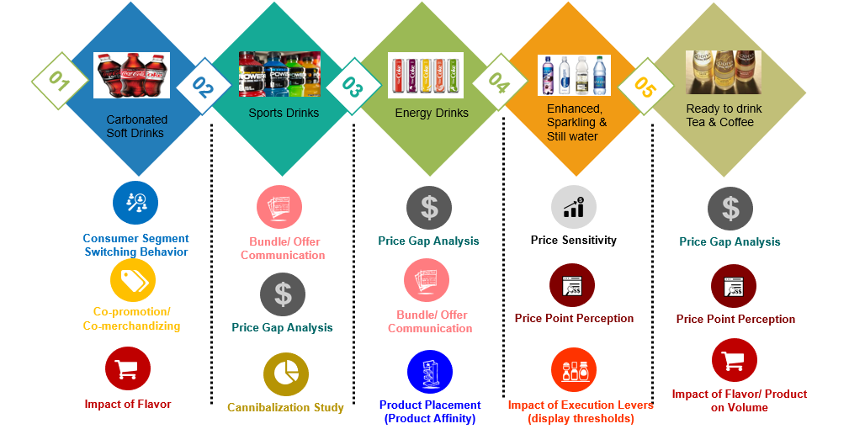
We have established ourselves as key strategic analytical partners Event Library & Integrated algorithms have provided reliable & actionable insights
Notes:
We worked with the category teams in sprints to answer key strategic questions. What Jason did was communicate with RGM teams to gather key strategic questions before the planning year. Through two week sprints, we provided analysis on topics such as price gap analysis, cannibalization, and execution. We would like your (Alex) and Brittni’s help in extending this value for the upcoming planning cycle.

